Slide 1
LENDING CLUB CASE STUDY SUBMISSION
Submitted By:
Ayushi Jetwani
Priyanka Bose

Slide 2
Abstract
The objective is to have the thorough understanding of the EDA and develop a basic understanding of risk analytics in banking and financial services and understand how data is used to minimize the risk of losing money while lending to customers.
The overview of this assignment is to help Lending Club identify the risky applicants and find the driving factors driving factors (or driver variables) behind loan default, i.e. the variables which are strong indicators of default. So, the company can utilize this knowledge for its portfolio and risk assessment.
For this case study the loan dataset has two kinds of attributes consumer attributes and loan attributes influence the defaulter list.

Slide 3
Methodology
Data Loading into Data frames(loan dataset)
Analyzing the data in these data frames
Data understanding (The domain knowledge for the analysis)
Data Cleaning
- Dropping unnecessary columns
-Removing NaN values or imputing accordingly
- Converting to proper dataType
Data Analysis
- Univariate
- Segmented Univariate
-Bivariate
Data Plot
Plotting our analysis and inferences in the plots

Slide 4
Analysis
This analysis starts with data understanding with 111 columns and 39717 records, where on the basis of domain knowledge and the data set understanding where we can indentify which all columns are necessary for our manipulation and further analysis
The process was divided into 3 categories where after data analysis :
Data Cleaning
Data Manipulation
Univariate, Segmented Univariated and Bivariate Analysis
Univariate - Distribution of categorical & numerical vars over
Segmented Univariate – Analyze variables against segments of other variables
Bivariate - Do correlation analysis of how two variables affect each other or a third variable
- We have verified the data types, checked the NaN values or null and imputed the same.Also Dropped the columns that were not interest to study .

Slide 5
Analysis
Some of the important factors for our analysis had been :
Loan_amount
Interest_rate
Annual_income
Loan_term
Purpose
home_ownership
Grade and Sub-Grade
Loan_Issue_Date
Emp_length
Verification_status
Loan_status
DTI
Public Record bankruptcies
Univariate Analysis
Histograms ,Box plots and Bar Charts to check the distribution of driver variables
Bivariate Analysis
Boxplots and bar charts plotted against important loan variables like loan_amount,loan_term,annual income etc.
It provided impactful insights for our anlaysis
Multivariate analysis to see how different variables interact with each other

Slide 6
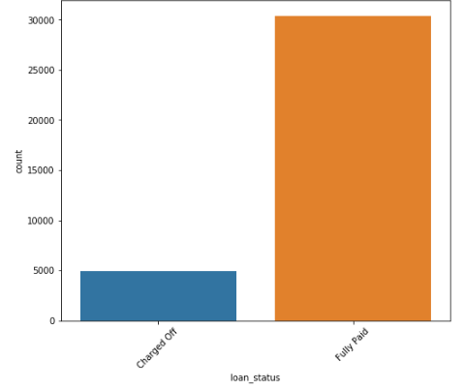
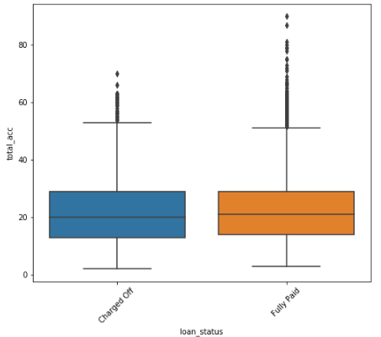
Analysis
Analyzing loan status based on the loan_amount count, total number of credit lines in the loan holder(total_acc) &
loan_amt
Inference:
We see approx 13.98% of loans have been defaulted
The borrower credit line (total_acc) info shows a linear relationship between loan amount and customer credit ratings

Slide 7
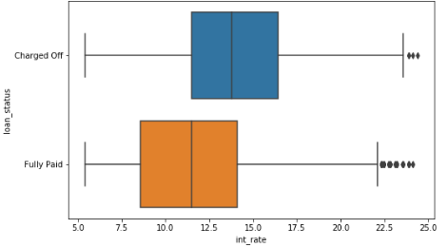
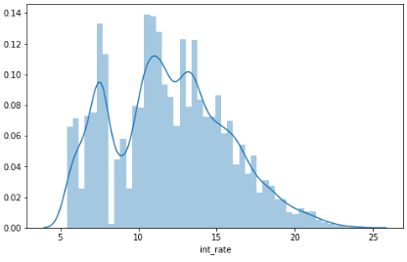
Analysis
Analyzing Interest Rate on the basis of loan_status
Inference
Overall, the interest rate varies from 5.42% to 24.4% with average interest rate of 11.8%.
And as expected the int rate for Charged Off loans appear to be higher than for Fully paid.

Slide 8
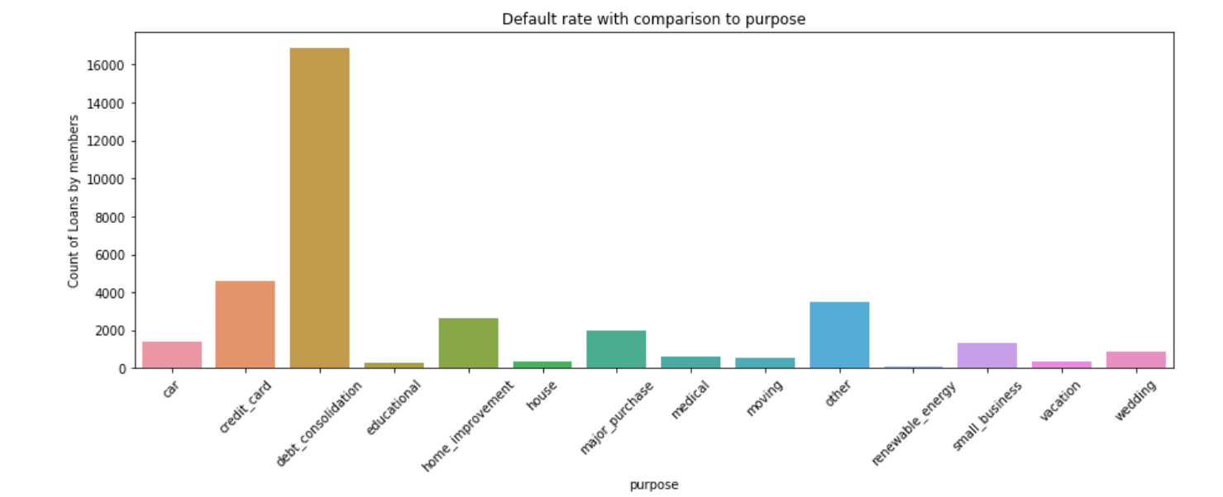
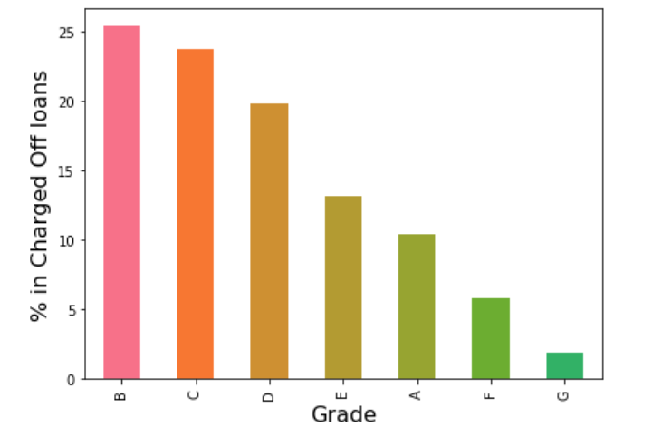
Analysis
Analyzing loan type that is the purpose & grade levels.
Inference
Charging higher interest rates for lower grade loans
Most loans were extended to high grades like (A and B) & they also seemed safe based upon the %Charged Off loans
Grade D, E, F, G loans seemed to have a higher defaulter list
Most loans were towards debt related category

Slide 9
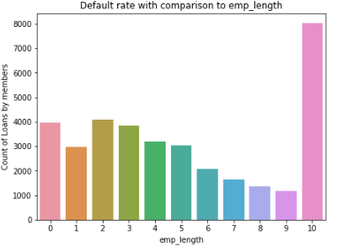
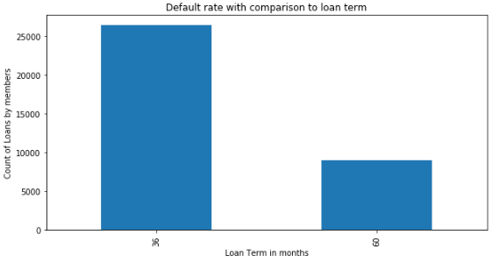
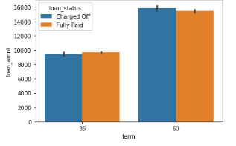
Analysis
Analyzing emp_length and loan_term against the loan_amount count
Inference
Most loans were taken for the shorter term ie.36 months(75%) and not 60(25%) months
Though 25% of the count of loans are those given for 5 years but 45 % seems to be Charged Off
22.7% of the of loan taker have an employment length of more than 10 years
Higher loan amount are associated with longer terms and see higher Charge Offs.

Slide 10
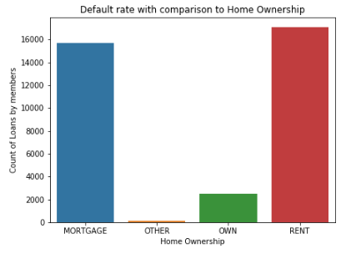
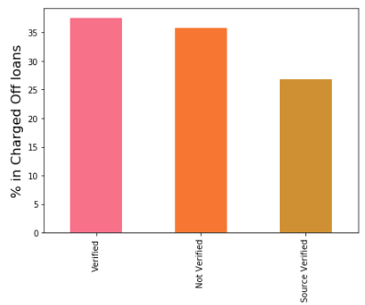
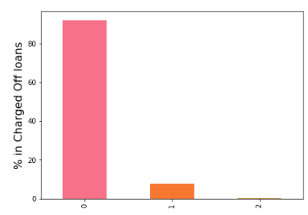
Analysis
Analyzing home ownership, verification status and public records
Inference
Rent and mortgage were the most popular categories among customers for the loans and hence they seem to have the most defaulters in there
From the defaulters dataframe as well, we can draw the same analysis where most loans are provided to the customers where the date is not verified which looks bit suspicious
94% have no Public derogatory records. 5% have 1 derogatory record.
Having even 1 derogatory record increases the chances of Charge Off significantly.

Slide 11
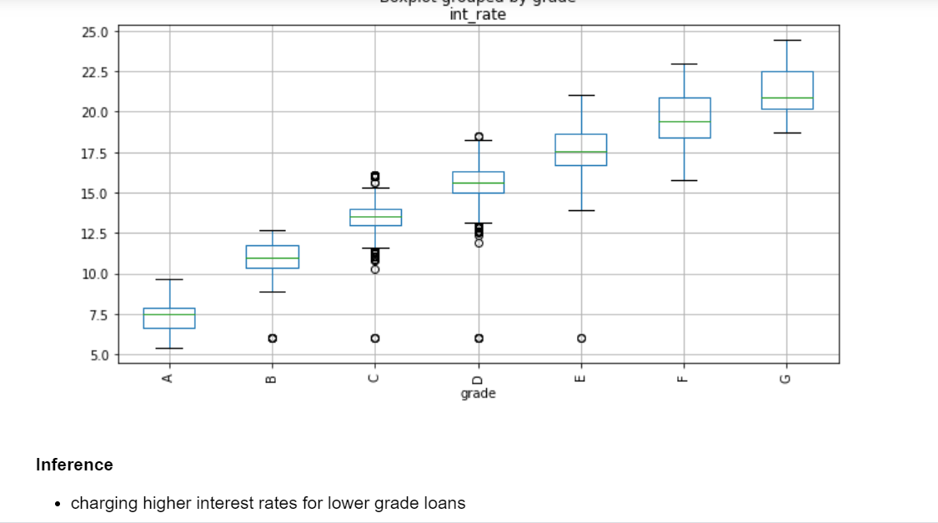
Analysis
Analyzing Grade & Interest Rate

Slide 12
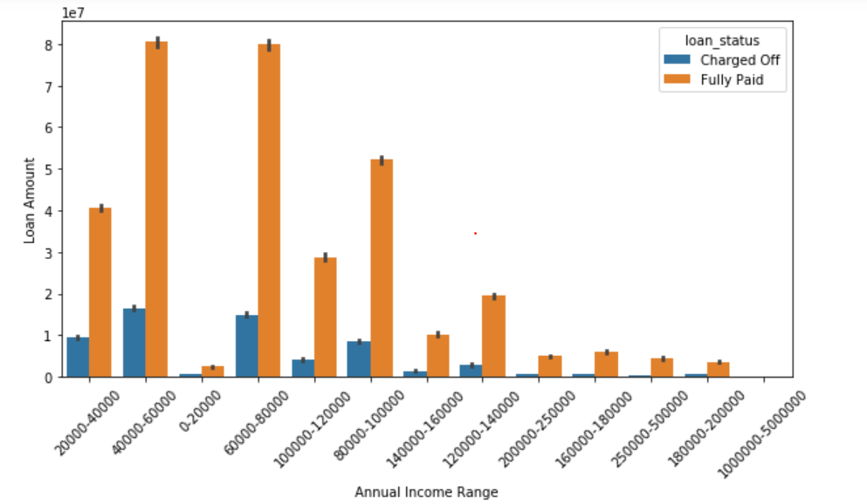
Analysis
Analyzing on the annual income of the borrower
Inference
We see most of the loans being charged off (default) for the annual income range bins : (40k-60k) & (60k-80k) -

Slide 13
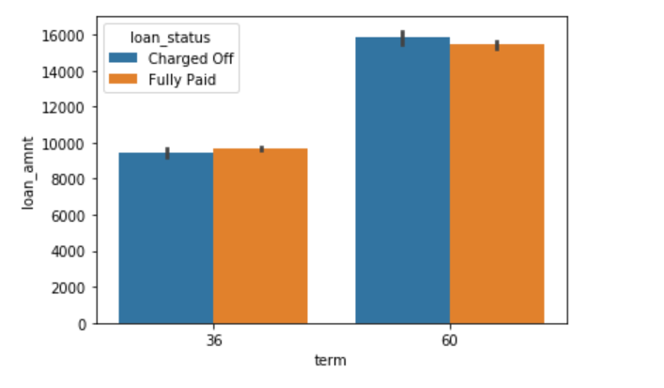
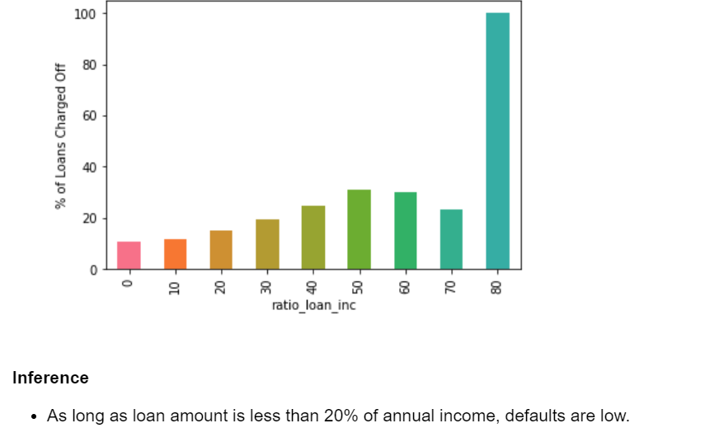
Analysis
Analyzing Loan amount Vs term Vs Loan Status
Inference :Higher loan amount are associated with longer terms and see higher Charge Offs.

Slide 14
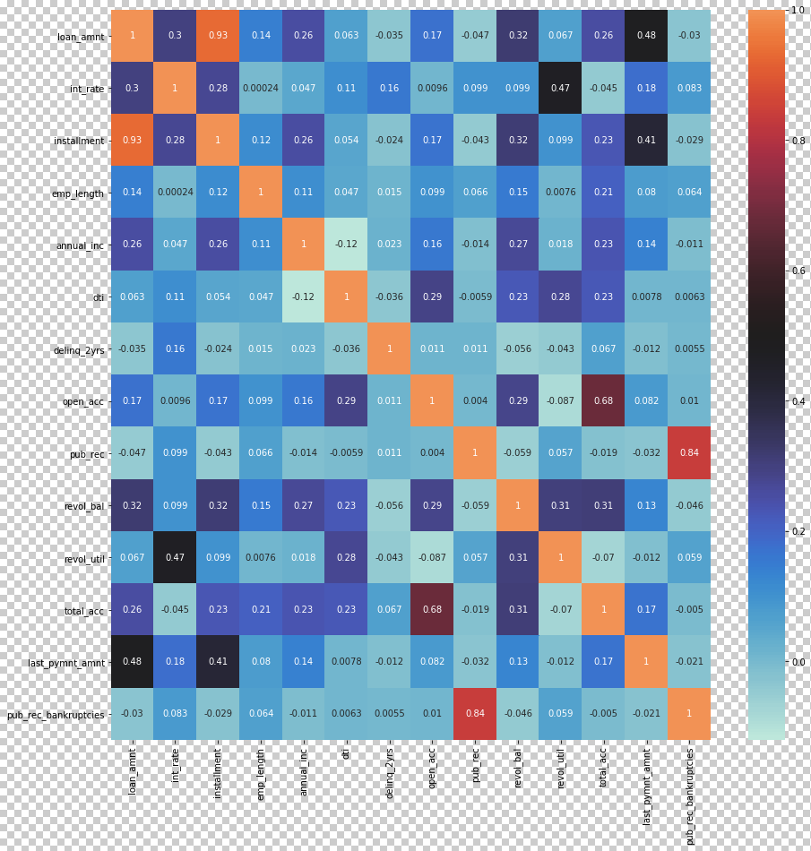
Analysis
Analyzing home ownership, verification status and public records
Inference
'int_rate' is correlated to 'revol_util' with r factor of .47 - This is good, as company is charging higher interest from riskier loan.
'pub_rec_bankruptcies' is highly correlated to 'pub_rec' hence expected bankrupt client who have higher derogatory public records
'last_payment_amnt' is well correlated to 'loan_amnt' & 'installment'

Slide 15
Analysis Results and Recommendations
Candidate whose loan amt > 30 % of their income
are the risker candidates for approving loans
Approvals of loans to people having bad image needs to be stopped.
Charging higher Interest for loans > 20 % as dept payment to income ratio higher than 20, higher percentage of loans are Charged Off.
Reducing loans for small business Types

